Slide 1

BDM Capstone Project
Inventory Analysis and Optimization for different Medicines from 4 different Manufacturers

Slide 2
Introduction
This project is done as part of Business Data Management course which is studied in Diploma level of IITM BS degree in Data Science and applications.
The project mainly focuses on a Medical Agency named “Ramesh Medical Agency” located at Anantapur, Andhra Pradesh. The business is B2B deals in the segment of wholesale pharmaceutical distribution.
Sri Ramesh Medicals is one of the leading businesses in the category of chemists in Anantapur.
It is also known for Paracetamol Tablet dealers, Cough Syrup dealers, Pharmaceutical Tablet dealers.
This well-known establishment acts as one-stop destination servicing various medical shops both local and from other parts of Anantapur.

Slide 3


Pictures of Organization and founder

Slide 4
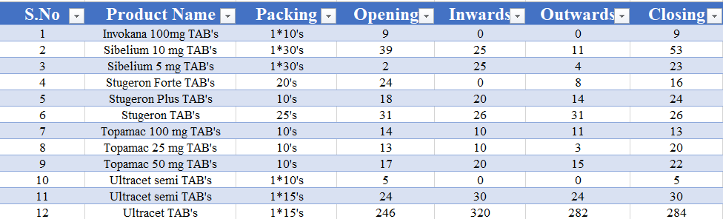
Data
I have collected the data of different medicines from 4 different manufacturers (Ethnor, Emcure, Alidac, MicroLabs) across 4 months (Jan, Feb, Mar, Apr). So the data is spread across 16 spreadsheets.
This is just a snap of the January data of manufacturer named “Ethnor”
I have also collected total opening value (in Rs), total sales value (in Rs), total closing value (in Rs) of every month for all 4 manufacturers, which is mainly used for comparative analysis of manufacturers.

Slide 5
Business Issues and my approaches
The major business issues that the organization is facing are related to a very nominal profit due to a large number of inventory stocks.
The issues will be addressed by analyzing the data via different analytical approaches to obtain a fruitful outcome.
I have tried to implement the following things in my project:
1. Sales Contribution
2. Monthly Inventory Trend
3. Percentage change in sales
4. Inventory Optimization
5. Manufacturers Sales Analysis
6. Manufacturer Comparison

Slide 6
Results and Findings
1. Percentage Sales Contribution
The main purpose of drawing this graph is to explain what amount of percentage of sales that their products are contributing to their overall sales.
High Value Products: R-Loc D TAB
Medium Value Products: Imol SYP, Imol Plus TAB, Etogesic ER TAB, R-Loc INJ, Thrombophob OINT
Low Value products: rest of the products
Similar charts are drawn for other 3 manufacturers.

Slide 7
Results and Findings Contd…

Slide 8
Results and Findings Contd…

Slide 9
Results and Findings Contd…

Slide 10
Results and Findings Contd…

Slide 11


Recommendations
Sales Contribution
It is recommended the owner to concentrate more on promoting and maximizing the sales of their highest-valued products, while considering the discontinuation of low-valued products.
Monthly Inventory Trend
It is recommended for the distributor that there is some seasonal trend observed in March because highest sales percentage is observed in Mar among 4 months among all manufacturers. So, give special attention to the sales that happen during March.
Inventory Optimization
It is recommended to the distributor to carefully address the stockout issues by ensuring adequate stock availability and consider adjusting inventory levels to meet the demand for products.
Manufacturer Comparison
EMCURE – has consistently high sales and market share
ETHNOR – lower total opening value and relatively slower pace compared to other manufacturers
MICROLABS – has stable closing value and comparable market position
ALIDAC – Smaller market share and fluctuations in tot sales value

Slide 12

Thank You !

